Slide 1
PID No:
TG0915208
10th Edition TECHgium®
Presentation Round
ThreatPath: AI-Assisted Threat Modeling and Security Validation for Embedded Systems
Author 1
Photo
Author 2
Photo
Author 3
Photo
Mohammed H
Mohammed J
RAJALAKSHMI M
PSNA College of Engineering and Technology, Dindigul, Tamil Nadu

Slide 2

Challenge Statement
INDUSTRY CONTEXT & REGULATORY MANDATE
• Hyper-Connected Architectures: Modern Software-Defined Vehicles (SDVs) integrate 100+ Electronic Control Units (ECUs) over CAN, CAN-FD, Automotive Ethernet, and cellular OTA.
• Strict International Regulations: ISO/SAE 21434 and UNECE WP.29 R155/R156 legally mandate verifiable Threat Analysis and Risk Assessment (TARA) throughout the engineering lifecycle.
• Manual Spreadsheet Bottleneck: Over 85% of OEM & Tier-1 threat modeling remains entirely manual (Excel tables & Microsoft TMT), requiring weeks of error-prone engineering time.
THE CORE CHALLENGE & INDUSTRY GAPS
• Siloed Component Analysis: Conventional tools evaluate components in isolation. They fail to trace multi-hop lateral attack paths (e.g. TCU cellular bug -> Gateway pivoting -> Brake controller spoofing).
• Lack of Dynamic Verification: Current threat models are purely theoretical 'shelf-ware'—they cannot empirically test or confirm whether a vulnerability is practically exploitable in code/protocol.
• Prohibitive Hardware & Testing Cost: Physical Hardware-In-The-Loop (HIL) penetration testing costs $15k–$30k per ECU and requires 4–8 weeks per validation cycle.
• The Challenge Objective: Develop ThreatPath: an automated platform that ingests embedded architecture (AUTOSAR/C code), synthesizes attack trees, and executes closed-loop validation in an isolated virtual simulation environment.

Slide 3
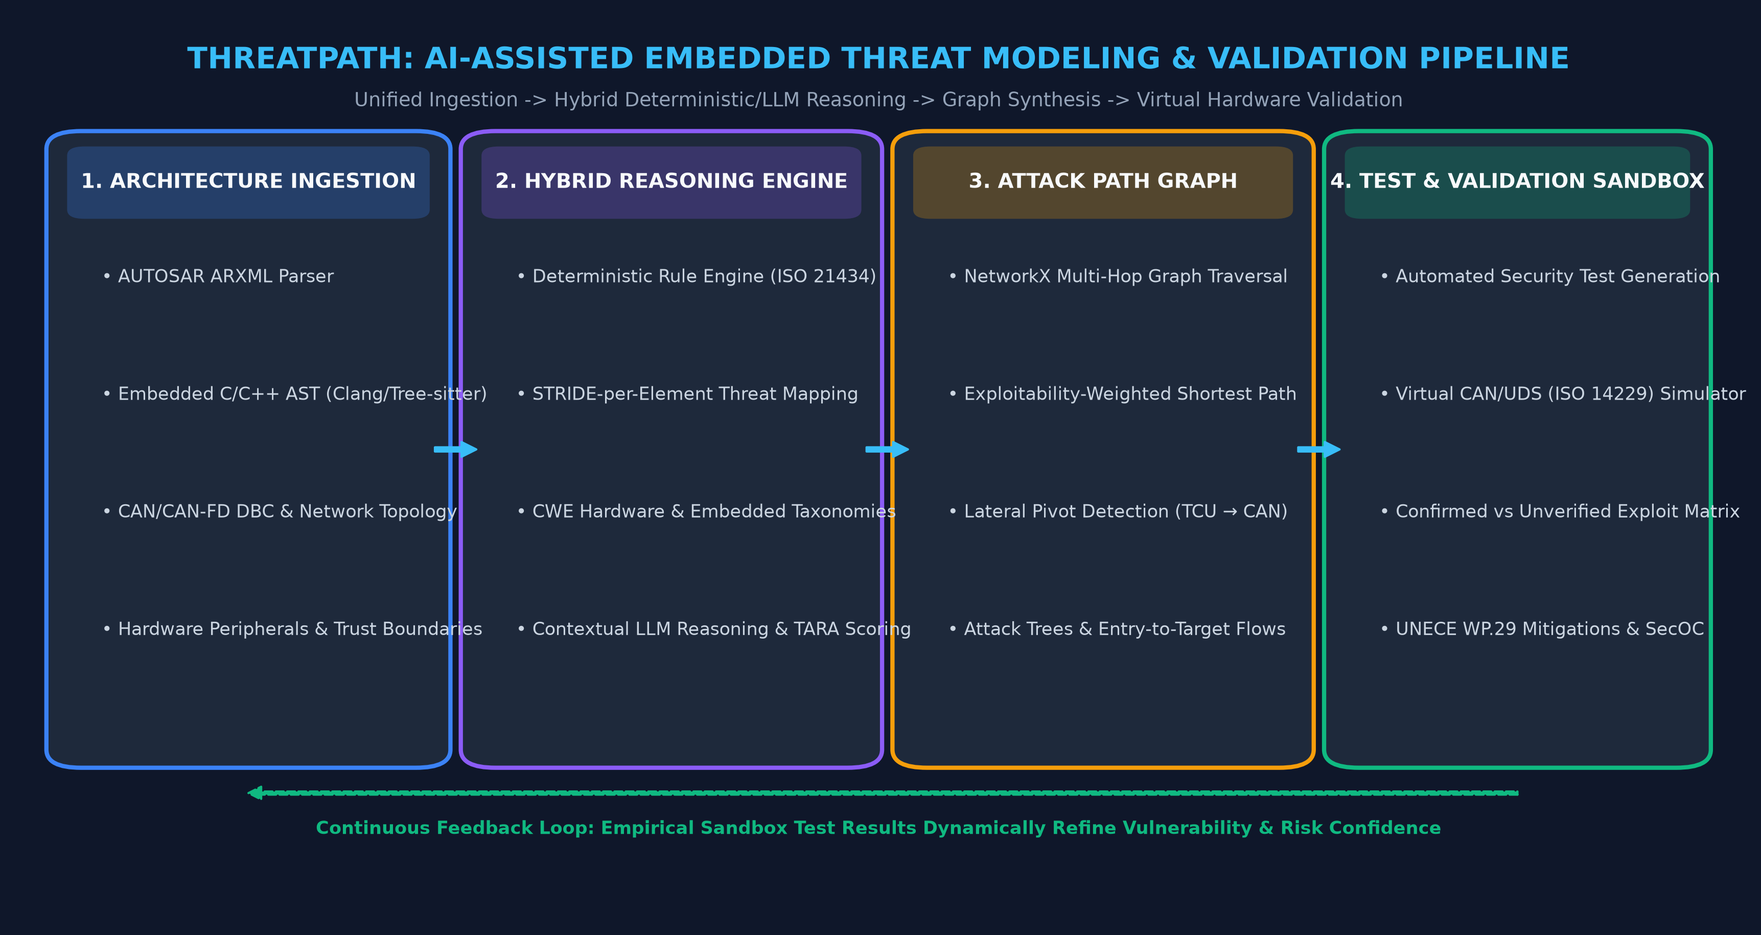
Concept / Proposed Solution

Slide 4
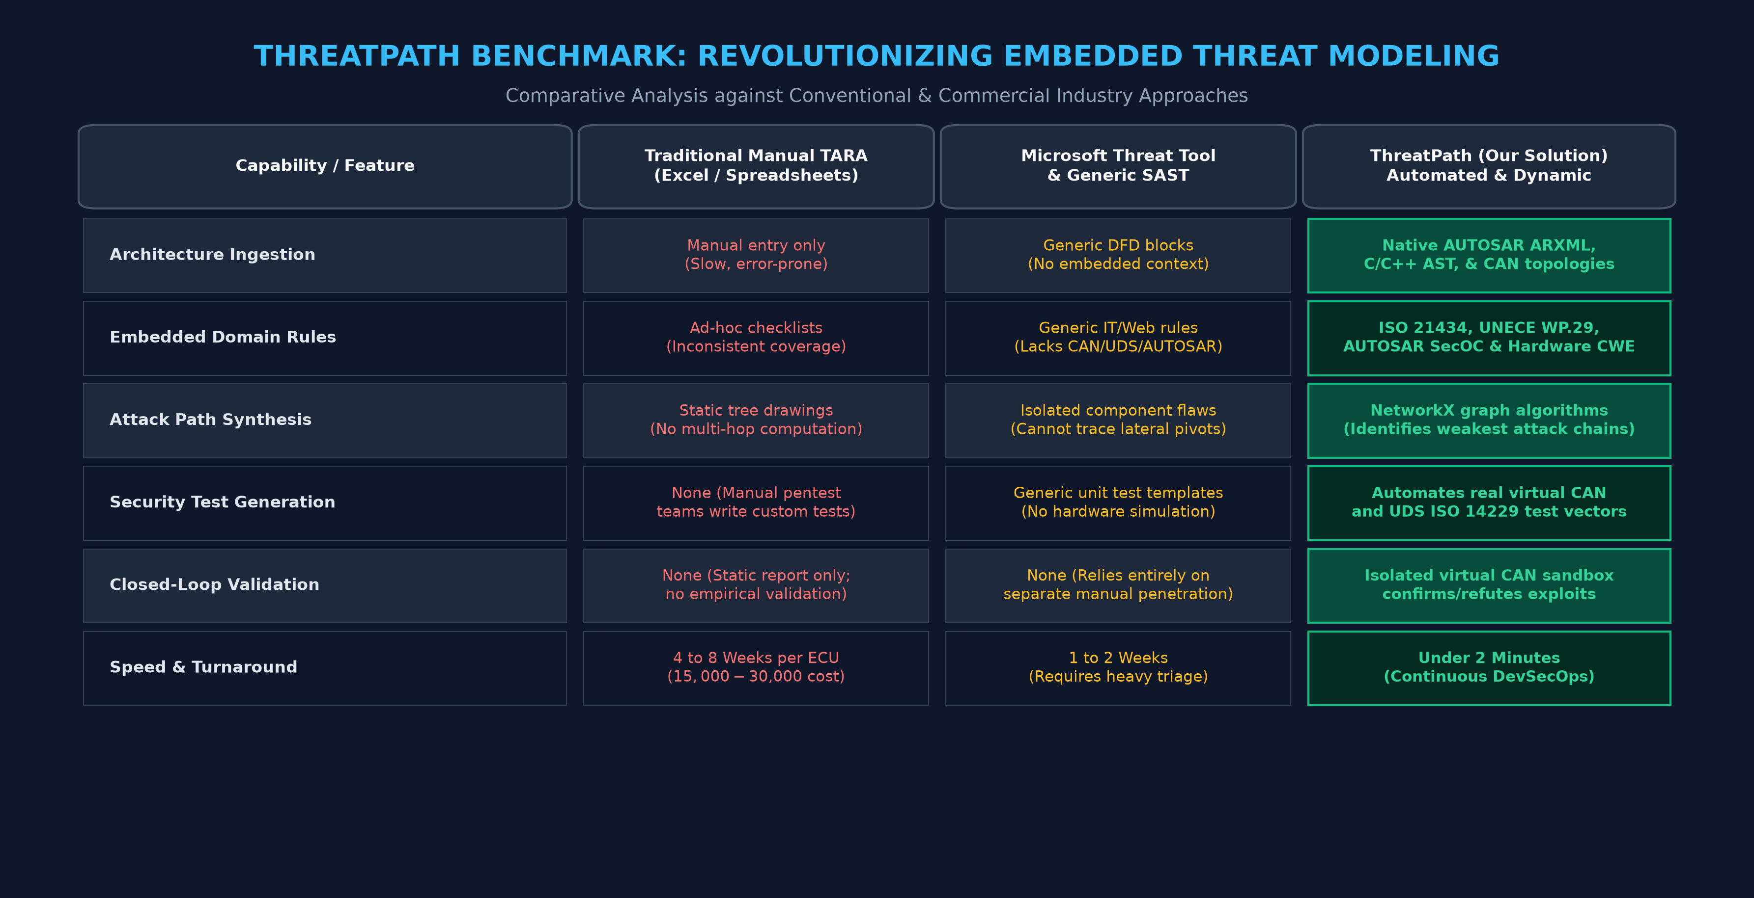
Pros and Cons of the solution

Slide 5
Technical Description
1. Multi-Modal Ingestion
• Parses AUTOSAR Classic & Adaptive ARXML (SWCs, Port Interfaces, PDU descriptors).
• Extracts CAN/CAN-FD DBC communication matrices and bus topologies.
• AST Static Analysis (Tree-sitter/Clang) scans embedded C/C++ firmware for memory flaws (CWE-120, CWE-121).
2. Hybrid Reasoning Engine
• Deterministic STRIDE-per-Element Matrix guarantees zero hallucination of security rules.
• Automotive Standard Alignment: Directly maps to ISO/SAE 21434 TARA & UNECE WP.29 R155.
• Contextual AI synthesis generates tailored mitigation guidance and threat summaries.
3. Attack Path Graph Engine
• NetworkX Directed Multigraph G=(V, E) models all ECUs, gateways, and buses.
• Dijkstra & Exploitability Algorithms discover weakest multi-hop attack routes.
• Detects Lateral Pivots: Traces remote cellular entry through gateway to safety brake controller.
4. Virtual ECU Test Sandbox
• Isolated virtual CAN socket (vcan) simulator with zero physical hardware risk.
• Crafts dynamic test vectors: UDS Diagnostic (ISO 14229) & CAN ID spoofing.
• Closed-loop verdict: Validates confirmed exploits vs. verified SecOC mitigations.

Slide 6
Implementation Plan
ALGORITHM: END-TO-END THREAT MODELING & VALIDATION
Input : ARXML System Spec, CAN DBC, C Code AST
Output: TARA Risk Report, Verified Attack Paths, SecOC Defenses
--------------------------------------------------
1. Construct System Graph G(V, E):
- V = {ECUs, Sensors, Memory, Diagnostics}
- E = {CAN, Ethernet, SPI, Trust Boundaries}
2. For each Component v in V:
- Query STRIDE-per-Element Deterministic Rules
- Scan AST for CWE Weaknesses (CWE-120, CWE-306)
- Assign Base Exploitability & ASIL Impact Scores
3. NetworkX Graph Synthesis:
- Compute multi-hop attack paths from External Ingress
- Identify critical Pivot Nodes (e.g. Central Gateway)
4. Automated Test Vector Synthesis:
- Generate targeted CAN frames & UDS payloads (ISO 14229)
5. Execute Test in Virtual ECU Sandbox:
- If target ECU accepts frame -> CONFIRMED EXPLOIT
- If rejected / timed-out -> UNVERIFIED THREAT
6. Verification of Mitigation:
- Apply AUTOSAR SecOC CMAC & Freshness counter -> Re-test
- Confirm frame rejection (0x7F 27 35 Access Denied)
FULL-STACK PRODUCTION IMPLEMENTATION
• Presentation Layer (Frontend): React 18 + Vite + TailwindCSS. Uses React Flow for interactive architecture & attack graph rendering, Lucide icons, and dynamic test console.
• Backend Application Engine: Python 3.11+ with FastAPI. High-performance async REST APIs, NetworkX graph modeling engine, and SQLite audit repository.
• Security Analysis Core: Tree-sitter & Clang AST parsers for C/C++ static inspection, combined with deterministic STRIDE/CWE rule tables.
• Hardware Simulation Sandbox: Pure virtual CAN emulation (python-can / socketcan) with UDS ISO 14229 diagnostic protocol test runner. Zero hardware dependencies.
• Executive Reporting Engine: Generates downloadable ISO/SAE 21434 & UNECE WP.29 security audit reports with cryptographic verification evidence.

Slide 7
Implementation Plan
Phase 1: Ingestion & Parser Core [Status: 100% COMPLETE]
• AUTOSAR ARXML parser for SWC, Port, and PDU extraction. • CAN DBC signal and message identifier parser. • Tree-sitter embedded C/C++ AST analyzer for CWE detection.
Phase 2: Hybrid STRIDE & TARA Engine [Status: 100% COMPLETE]
• Deterministic STRIDE-per-element rule classification. • ISO/SAE 21434 risk scoring matrix (Safety ASIL, Financial, Operational). • NetworkX directed attack graph and lateral pivot traversal.
Phase 3: Virtual CAN & UDS Test Sandbox [Status: 100% COMPLETE]
• Isolated virtual CAN socket emulator without hardware requirements. • Automated test generator for UDS Diagnostic (ISO 14229) & frame spoofing. • Dynamic exploit verification & SecOC mitigation re-testing.
Phase 4: Dashboard & Interactive Visualizer [Status: 100% COMPLETE]
• React Flow architecture canvas with real-time node drilldowns. • Live attack tree exploration with exploitability paths. • Executive PDF / JSON compliance report generation for ISO 21434.
Phase 5: Automotive Scenario & Jury Demo [Status: READY FOR JURY]
• Pre-loaded connected vehicle ECU scenario (TCU -> Gateway -> Braking). • One-click end-to-end execution demonstrating threat-to-validation in 60s. • Fully runnable local prototype for seamless presentation round demo.

Slide 8
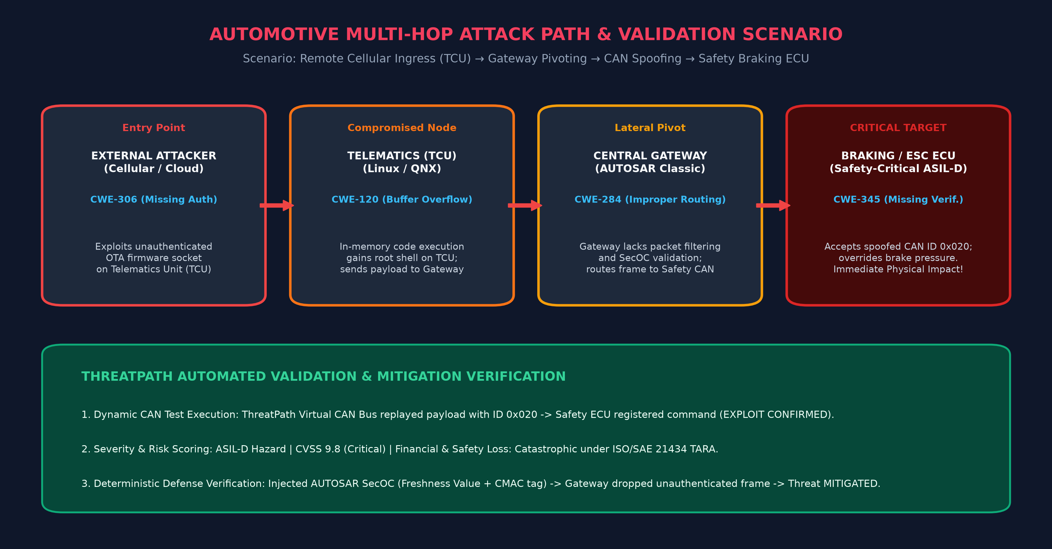
Validation / Testing / Analysis

Slide 9
Cost Estimate
TRADITIONAL INDUSTRY SECURITY AUDITING
• External TARA & Pentesting Firms: $15,000 to $30,000 per individual ECU audit cycle.
• Physical HIL Testbench Hardware: $100,000+ capital investment per hardware test bench (dSPACE, Vector VT System).
• Development Turnaround Delay: 4 to 8 weeks latency per iteration; cannot run in continuous CI/CD pipelines.
• Human Expertise Scarcity: High dependency on rare automotive embedded cybersecurity specialists.
• Annual Cost for 1 Vehicle Program: > $450,000 annually across 15–30 safety-critical ECUs.
THREATPATH SOLUTION COST & ROI
• Software Infrastructure: Built on open-source foundation (React, FastAPI, NetworkX, Clang/Tree-sitter). Zero per-seat licensing fees.
• Hardware Cost: $0 Physical Hardware. Uses fully isolated virtual CAN (vcan) software emulation.
• Compute Infrastructure: Lightweight containerized deployment ($50/month cloud host or $0 on local workstations).
• Execution Turnaround Time: Under 2 minutes per comprehensive architecture threat model and validation run.
• Total Savings & ROI: > 92% cost reduction in recurring cybersecurity engineering budgets, enabling daily Shift-Left verification.

Slide 10
Assumptions
ENGINEERING ASSUMPTIONS & OPERATIONAL SCOPE
1. Automotive Communication Standards: Target ECUs utilize standard automotive protocols including CAN 2.0B, CAN-FD, UDS (ISO 14229-1), and Automotive Ethernet (DoIP ISO 13400).
2. Architecture Specification Format: Input architectures are modeled following standardized AUTOSAR Classic/Adaptive specifications (ARXML) or structured topology descriptions.
3. Strictly Isolated & Ethical Simulation: All automated dynamic tests execute strictly inside isolated virtual socket containers (vcan/socketcan). No live vehicle networks or unauthorized external systems are scanned.
4. Regulatory & Compliance Grounding: Risk ratings and threat taxonomies are strictly grounded in ISO/SAE 21434 (Road Vehicles — Cybersecurity Engineering) and UNECE WP.29 R155/R156 standards.
5. Complementary Physical Verification: ThreatPath is designed as a Shift-Left security validation tool that dramatically shortens development cycles; final physical environmental and side-channel audits remain complementary.

Slide 11
References
KEY STANDARDS, REGULATIONS & ACADEMIC REFERENCES
[1] ISO/SAE 21434:2021: Road vehicles — Cybersecurity engineering, International Organization for Standardization / SAE International.
[2] UNECE WP.29 Regulation No. 155 & 156: Cyber Security and Cyber Security Management Systems; Software Update and Software Update Management Systems, United Nations.
[3] AUTOSAR Specification of Secure Onboard Communication (SecOC): Classic Platform Release 4.4.0, AUTOSAR Development Partnership.
[4] ISO 14229-1:2020: Road vehicles — Unified diagnostic services (UDS) — Part 1: Application layer specification.
[5] MITRE ATT&CK for Industrial Control Systems (ICS) & CWE-Hardware: Common Weakness Enumeration for Embedded Design (CWE-120, CWE-306, CWE-345).
[6] Shostack, Adam: Threat Modeling: Designing for Security. John Wiley & Sons, Indianapolis, IN, 2014.
[7] Checkoway, S., et al.: Comprehensive Experimental Analyses of Automotive Attack Surfaces. In USENIX Security Symposium, 2011.

Slide 12
Thank You
ThreatPath: AI-Assisted Threat Modeling & Security Validation
PID No: TG0915208 | L&T TECHgium 10th Edition
Team Members: Mohammed H, Mohammed J, RAJALAKSHMI M
Institution: PSNA College of Engineering and Technology, Dindigul, Tamil Nadu
Prototype Demonstration: Full-Stack React + FastAPI application running live locally with virtual CAN ECU exploit simulation.
Ready for Jury Discussion: Open for Q&A, technical architecture deep-dive, and live test demonstration.

